Slide 1

First Beyond GDP Sprint Meeting of the United Nations Network of Economic Statisticians

Slide 2
Welcome

Slide 3
Agenda – shown in UK time
12:00 – 12:15 Welcome and introduction – Stefan Schweinfest, Director of United Nations Statistics Division and Richard Heys, Deputy Chief Economist, Office for National Statistics
12:15 – 12:45 Intangible Assets – Jonathan Haskel, Imperial College Business School and Bank of England
12:45 – 13:20 Data as an asset – John Mitchel, (OECD)
Country Presentation by Sean Crick, Australian Bureau of Statistics
13:20 – 13:30 Break
13:30 – 14:00 Natural Capital – Bram Edens, UN, Carl Obst, ME and Mark de Haan, IMF
14:00 – 14:30 Human Capital – Gueorguie Vassilev, Office for National Statistics
14:30 – 14:45 Consolidating discussion, Richard Heys, Deputy Chief Economist, Office for National Statistics
14:45 – 15:00 Next steps and closing remarks – Erich Strassner, Associate Director for National Economic Accounts, US Bureau of Economic Analysis on Distributional Sprint

Slide 4

Beyond GDP Sprint Session One: Measuring Modern Capital
Richard Heys (ONS)

Slide 5
High level Sprint objectives
“What we measure affects what we do. If we have the wrong metrics, we will strive for the wrong things.”
(Stiglitz, Fitoussi & Sen 2010)
While the Stiglitz Report set the dimensions of the global debate around ‘Beyond GDP’, it was not prescriptive of specific approaches or measurement. Since then, many approaches, frameworks, and specific measures have been put forward.
The sprint’s objective is to review the potential to agree an extended framework for measuring all aspects of economic activity, in a way which is compatible with GDP / national accounts, but captures key elements excluded from that measure.

Slide 6
Sprint Design
Session One: Modern Capital
Sessions Two & Three: Distributional Accounts
SNA update issues, environment, wellbeing (Fitoussi, Stiglitz and Durand report)
Session Four: Population and wellbeing
Socio-demographic disaggregation of national accounts, vulnerability, HDI index
Session Five: Synthesis and Next Steps

Slide 7
Sprint One: Modern Capitals
‘What does capital look like in the modern economy, and how should we measure modern capital and its flows of benefits?’
Scope:
What is modern capital and where do we classify it?
How does our current measurement techniques impact on our understanding of modern capital?
How do we think about ownership v use?
How do we think about capital assets which are not exclusive or rivalrous?
Does the produced / non-produced boundary help or hinder efforts to understand modern capital?
How do we tackle capital which isn’t defined by national borders?

Slide 8
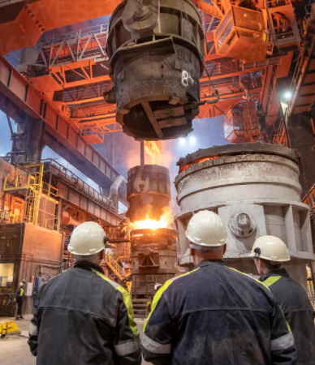





Defining Capital
We need to agree which types of capital we consider to be in scope:
SNA 2008 Para 10.8 An asset is a store of value representing a benefit or series of benefits accruing to the economic owner by holding or using the entity over a period of time. It is a means of carrying forward value from one accounting period to another.
But not just economic statistics contain capital assets – many statistical domains cover assets beyond the traditional economic asset boundary.

Slide 9
Classification of Statistical Activities Mapped to Measuring Capital
Domain 1: Demographic & Social Statistics
Domain 2: Economic Statistics
Domain 3: Environment & Multi-Domain Statistics
1.5 Income & Consumption
1.9 Culture
2.2 Economic Accounts
2.3 Business Statistics
2.9 Science technology & innovation
3.1 Environment
3.3 Multi-Domain Statistics
Household Satellite Account
Theatres, Cinemas
Integrated Economic Accounts
Acquisition & Disposal of Capital
Human Capital
Environment
Information Society
Museums & Libraries
Flow of Funds & Capital Services
Entrepreneurship
Books
Household Durables
Cultural Capital
Financial and Non-Financial Capital
Human Capital
Natural Capital
‘Uncapitalised’ Intangible Capital

Slide 10
Measuring the value of modern capital
Sum of Costs of Production = Expected Sum of Discounted
+ Margin flow of benefits
Under assumption of perfect competition, institutions will invest up to the point equal to the discounted sum of future benefits.
However, numerous reasons why this may not be the case in market economy, even harder to assume perfect competition outside of the market:
Human Capital – credit market constraints
Risk aversity – without perfect foresight, investors may exhibit caution
Future benefits may be dependent on other investments / decisions – particularly natural capital may see cliff-edges in returns
Fast-moving innovation (e.g. technology) makes it increasingly hard to form expectations of future returns
Sufficiently long-lived assets can find new purposes and renewed benefit streams
Is it valid to assume the different methods are consistent?

Slide 11
Ownership & Use
Many assets are owned by someone other than the user.
The current treatment of capitals within the accounts mean some payments to access assets are treated as rentals, some as rents, and particularly for infrastructure held by the public sector either not at all or indirectly through taxes.
Practical problems at identifying ownership, particularly in the context of globalisation.
Human capital lies outside the core national accounts framework, for technical reasons but even if it did not, who owns human capital and who utilises it? How could its rewards be treated – as compensation or a rent?
Atmosphere and natural capital raise similar questions of ownership and usage. Pollution does not know borders and trees sequester carbon no matter where, or by whom it is emitted.
ICT hardware has been increasingly replaced by many firms with cloud services: Capital services commensurately fall and intermediate consumption rises, but from a productivity perspective the same capital services are being delivered.
Do we need to consider how best to address this in a consistent manner?

Slide 12

How do we think about capital which is not exclusive?
Physical, tangible assets can be owned and exclusivity enforced, but intangible assets can be utilised in very different ways, potentially coming close to being public goods with non-rival, non-excludable qualities.
Traditional and digital infrastructure (roads and mobile phone networks) have very similar qualities (if not perfect non-rivalry).
Many capitals are currently being replaced with services, such as cloud-computing, that not only don’t preclude someone else using the same ICT assets, but is designed to optimise use of these across multiple users, including open-source software.
Do we need to stand back and consider whether we need to focus more on private and non-exclusive capitals.

Slide 13
Does the produced / non-produced boundary help understand modern capital?
The national accounts currently distinguish between produced and non-produced assets, but there is an increasing need to better reflect the flow of services which don’t fit neatly into a produced/non-produced dichotomy:
Environment
Data
Crypto-assets
Human Capital (Nature v nuture)

Slide 14

How do we tackle capital which isn’t defined by national borders?
How do we tackle capital which isn’t defined by national borders?
The need to understand the relationship between the economy and the environment has never been stronger, and the need to find ways to address the full range of environmental services is becoming increasingly apparent, (but not forgetting open source software)

Slide 15
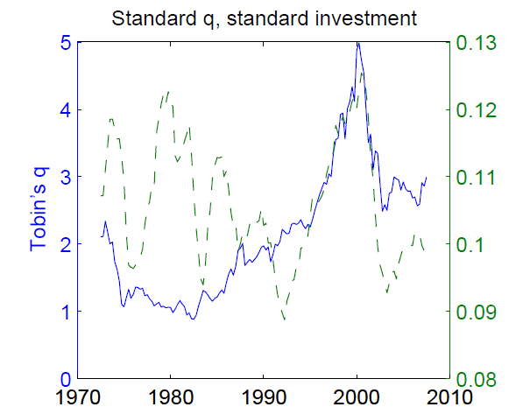
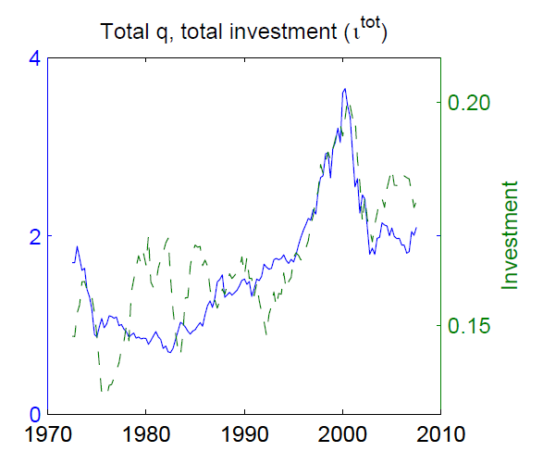
National Accounts v Business Accounts
Business accounts are increasingly less transparent as intangible assets are not recorded. As firm’s stock market values diverge from the value of assets recorded, it is clear that many firms derive their value from intangibles (Peters and Taylor 2017), and are not always keen to reveal these.
National accounts needs this data however, particularly as intangibles represent an increasing share of gross fixed capital formation, and in some cases now form the majority of investment, particularly if we include uncapitalised intangibles.

Slide 16
Any Questions?

Slide 17
Intangible assets
Jonathan Haskel
@haskelecon
Imperial College Business School and Bank of England
UN Beyond GDP sprint on Modern Capitals, 10th March 2022.
Views are my own.

Slide 18
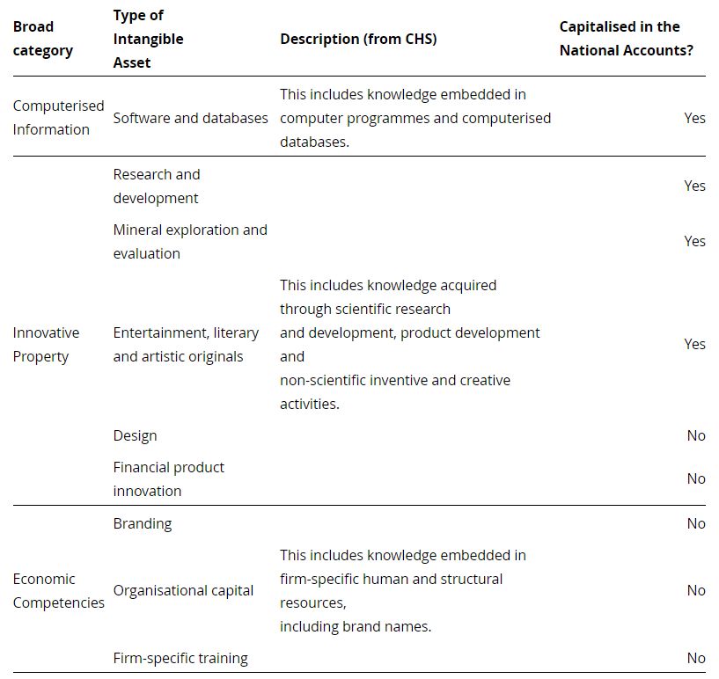
Intangible assets framework
Source: UK ONS adapting Corrado, Hulten and Sichel (2005)

Slide 19
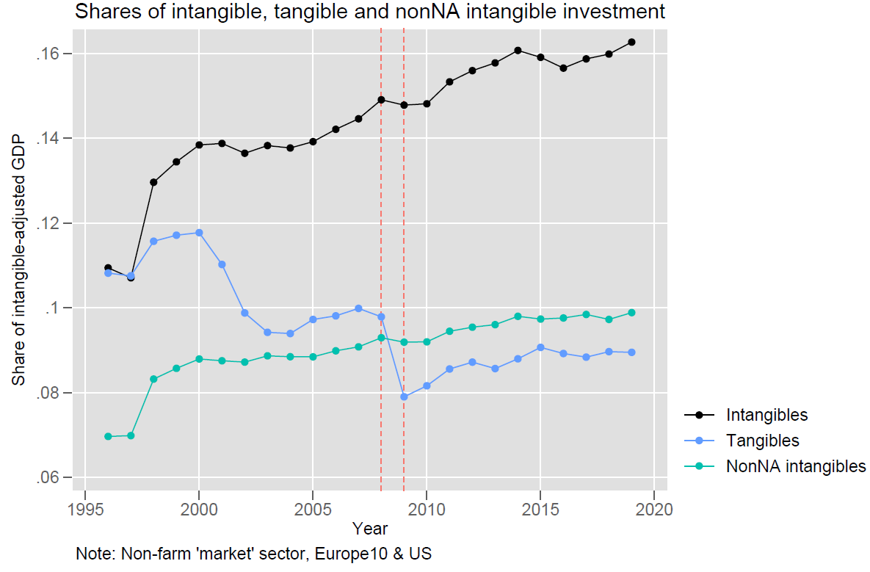

Slide 20
Intangible investment exceeds tangible investment in many countries, with uncapitalised intangibles accounting for the majority
Source: EU KLEMS forthcoming, authors’ calculations

Slide 21
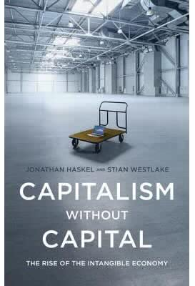
The four economic properties of intangibles and implications for measurement
Scalable
Intangible assets can often be used over & over, in multiple places, with little or no reinvestment.
There is likely to be a wide variation in rates of depreciation (obsolescence) for some intangibles.
Spillovers
A firm making an intangible investment will not receive all (or perhaps any) of the returns.
Some intangibles are quasi-public goods (adding to open knowledge) while others may start as private goods and later become public.
Sunk
Once a firm makes an intangible investment, hard to sell it or recover its value.
Intangibles often don’t show up on balance sheets, and businesses do not keep data on them, as they cannot use them for collateral.
Synergies
Intangible assets are often especially valuable when combined with other intangibles and human capital
Rates of return on intangible assets may be non-linear, and depreciation rates could even be negative at times.

Slide 22
Measuring intangible investment is a game of two halves
Tangible assets
Intangible assets
95%
Purchased investment – a firm buys another unit’s output on the market
Own-account investment – a firm develops an intangible asset in-house for its own use
40%
5%
Mostly dwellings
60%
70% for only capitalised intangibles
Source: authors’ calculations from ONS sources

Slide 23

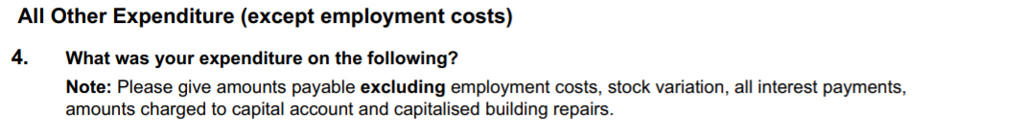
Purchased investment is ‘easy’ if you know where to look
BUT
Is definition different from current intermediate consumption product breakdown?
Do businesses hold such data to reliably report?

Slide 24
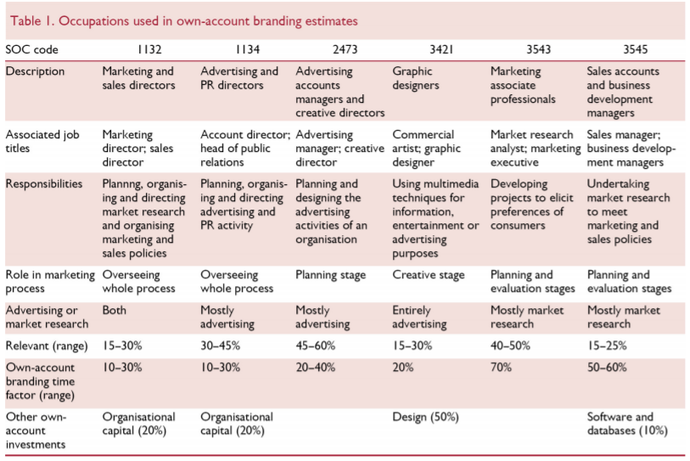
Own-account investment needs much more research, but it is possible
Wages and salaries of relevant workers
Multiplied by
A scale-up factor for non-wage labour costs
Multiplied by
A scale-down factor for time spent on non-investment activities
Multiplied by
A scale-up factor for non-labour costs
Multiplied by
A sales-adjustment factor for those industries that produce the relevant good for sale (so as to avoid double-counting with ‘purchased’ investments)
Source: Martin, 2019

Slide 25


Boundaries: human capital and training
Management and communication skills
How my organisation works
How to make good charts in Microsoft Excel
How to use firm-specific software
How to fill in that form
How to code in Python
How to write effective reports
Acronyms and terms used in my organisation

Slide 26
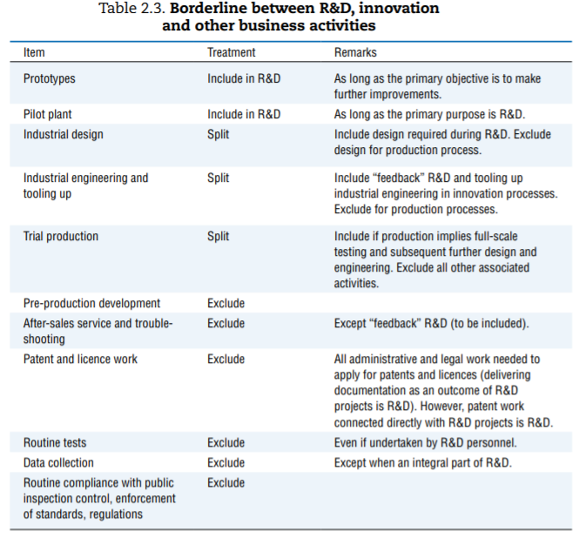
Boundaries: R&D with design and software
Design (process)
Design (product)
Source: Frascati Manual 2015

Slide 27
Boundaries: current vs capital spending
“Fixed assets are produced assets that are used repeatedly or continuously in production processes for more than one year. The distinguishing feature of a fixed asset is not that it is durable in some physical sense, but that it may be used repeatedly or continuously in production over a long period of time, which is taken to be more than one year.”
SNA 2008, 10.11

Slide 28
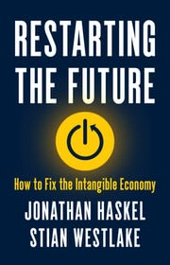
Thank you
References
Corrado, C., Hulten, C., & Sichel, D. (2005). “Measuring capital and technology: an expanded framework.” In Measuring capital in the new economy (pp. 11-46). University of Chicago Press.
Haskel, J. & Westlake, S. (2017). “Capitalism without capital.” Princeton University Press.
Martin, J. (2019). “Measuring the Other Half: New estimates of intangible investment from the UK Office for National Statistics” National Institute Economic Review
OECD. (2015). “Frascati Manual 2015: Guidelines for Collecting and Reporting Data on Research and Experimental Development”. The Measurement of Scientific, Technological and Innovation Activities, OECD Publishing, Paris.
United Nations, European Commission, IMF, OECD, World Bank. (2009) “System of National Accounts 2008”.
Published:
22 March 2022 (UK)
5 April 2022 (US)

Slide 29
Modern capital – Data as an asset John Mitchell (National Accounts Division - OECD)
John.mitchell@oecd.org

Slide 30
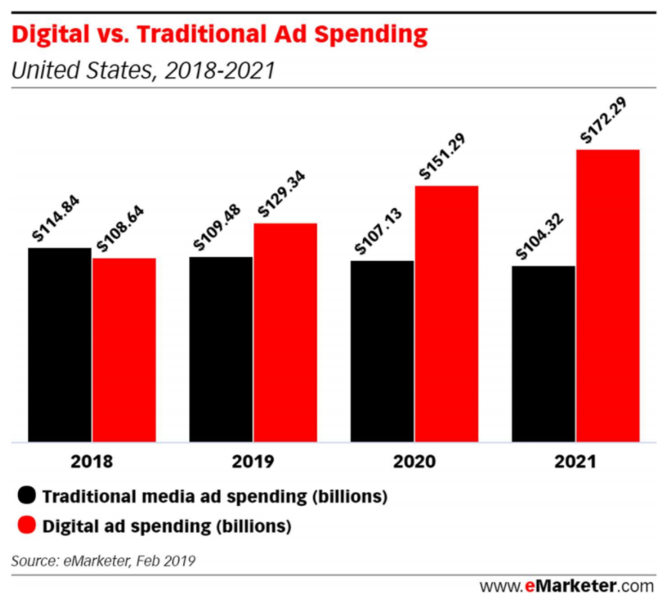
Modern Capital - Data as an asset
What assets are used in the production of Digital advertising?
Computer hardware
Computer Software
R & D
…
X Data

Slide 31

Modern Capital - Data as an asset
Data contributes to improved productivity & efficiency in a range of industries.
Just-in-time supply chain control
Customer loyalty programs
Improved demand forecasts
Not just the private sector; public sector data has transformed many aspects of non-market output!

Slide 32
Data vs other assets in the National Accounts.
Most data is produced on an own account basis.
Data doesn’t depreciate.
Data is extraordinarily heterogeneous, most value based on specific content and context.
Data used in production can be non-rivalrous.
Quantity of data is often unrelated to the value of the data.
Service life of data is extremely varied.
Data creation by governments can be considered an input to improve government output (tax or social security databases) or as a pubic good itself.

Slide 33
Data in the National Accounts Considerations for inclusion
Consider data entirely the result of production.
Value of data is based on sum-of-costs.
Assumptions based around service life – current vs capital cost.
Likely to be calculated at an aggregate level, examples by Statistics Canada and Goodridge et al. (Modelled rather than direct reporting).

Slide 34
Data in the National Accounts Additional thoughts
Testing is required to set user expectations on impact of the accounts (capital formation, capital stock & GDP).
Are we appropriately reflecting who is responsible for the value added?
How does legislative decisions impact the treatment of ownership of data in the accounts?

Slide 35
Country experience: Measuring data as an asset in Australia

Slide 36
Where are we at?
Data-related investment: data/database/data science
Cost-of-production approach (salary, non-direct salary and other intermediate input costs, cost of capital)
Applied lower-upper bounds for robustness
Sense-of-magnitude estimates, though they present overlap to a degree with published components.
Notes:
In June 2021, the ABS presented the preliminary estimates of data-related investment following the methodology introduced in Statistics Canada (2019) work. The working assumption was data is an economic asset providing a flow of services which are used (across a period greater than one year) in production functions.
Three broad types of data-related assets that the cursory estimates for investments were presented: data, databases and data science.
To estimates the investments, the Statistics Canada used the sum-of-cost approach, which summed up salary, non-direct salary and other costs, which the ABS initially replicated.
The main challenges with this early phase of the work involved in occupation mapping (NOC to ANZSCO) and the working assumption on the ‘Data’ shares of production activity related to relevant occupations. To mitigate the subjectiveness, lower-upper bound estimates were provided.
The prelim estimates for data-related investments are shown in next slide. Total data-related investments were estimated at $bil 35-47 in 2016 (current prices) or 2.2-2.8% GDP in 2016.
These amounts cannot be directly added to existing estimates of gross domestic product, since they overlap to a degree with components in the already the published estimates.

Slide 37
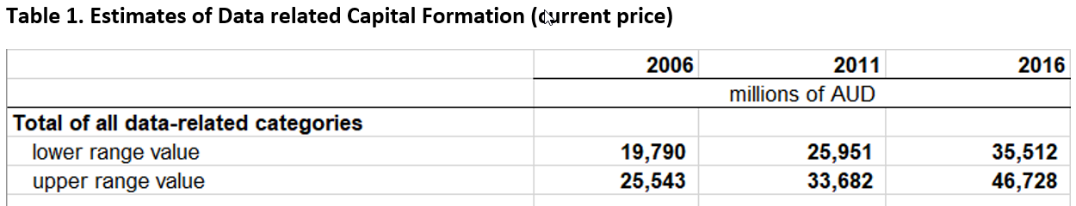
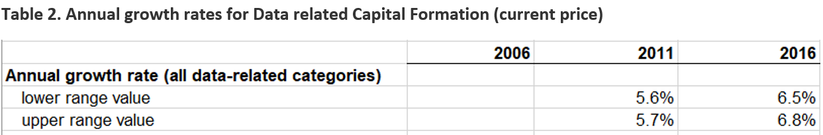
Data-related capital formation

Slide 38
Where are we at? (cont.)
Preliminary estimates of net capital stock for data (databases and data science currently excluded) based on Perpetual Inventory Method.
Sensitivity test for:
Price indexes: WPI vs. Inhouse computer software (SOI) deflator vs. weighted measure
Asset lives: 3-year mean asset life vs. 25-year mean asset life (Stats Canada)
Notes:
Why not Databases and Data Science?
These will be looked at in future work. A subjective decision was made based on the following assumptions:
Data Science would have the largest overlap with R&D.
Databases is already captured and valued in the current SNA concepts.

Slide 39
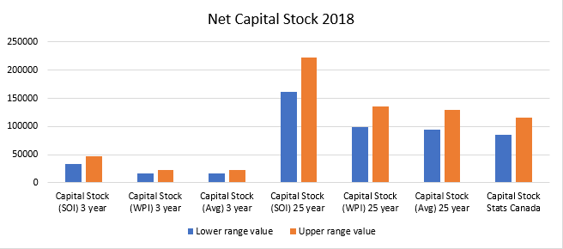
Net capital stock - Data

Slide 40
Future work
Improve in estimates of investment in data-related assets
Occupation mapping (NOC – ANZSCO; 6 digit ANZSCO)
Reassess assumptions on share of production activities
Refine estimates of capital stock for data-related assets
Expand coverage of the experimental estimates (databases and data science)
Reassess assumptions and collect real world information (asset lives, price indexes)
Review overlap with existing estimates (e.g. R&D)
Assess impact to productivity estimates

Slide 41

Break

Slide 42
Measuring natural capital and the relationship between SNA and SEEA
Bram Edens, PhD.
United Nations Statistics Division

Slide 43
Outline
Context on SEEA
Defining natural capital in SEEA
Measuring natural capital
Beyond GDP

Slide 44


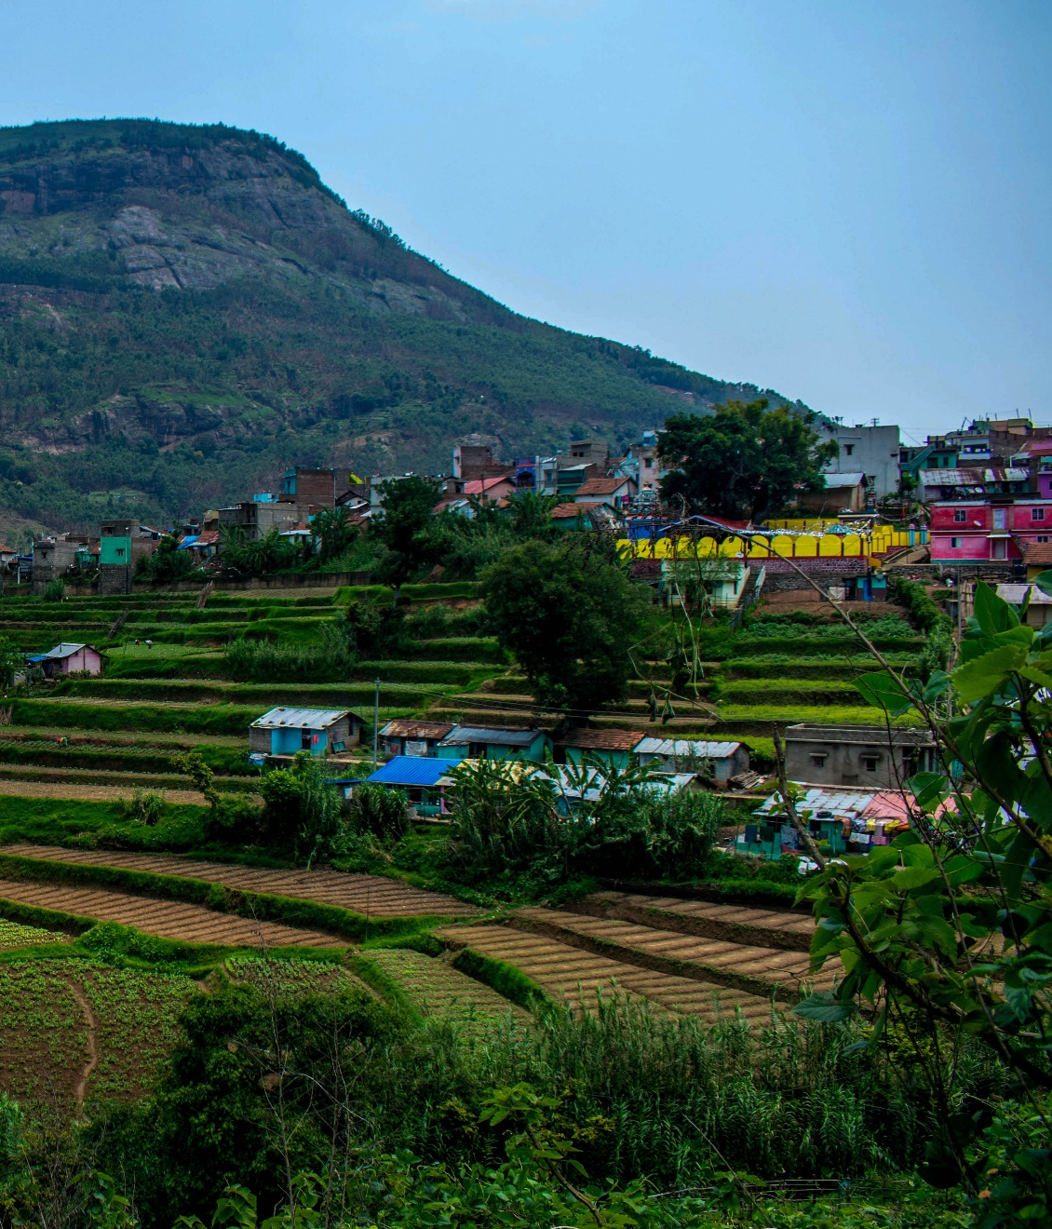

The Need
Our economy and well-being crucially depends on nature
Recognize natural capital as asset:
Provide flows of benefits to people
Stocks that can be degraded / depleted or enhanced / restored
Both aspects important to assess the impacts and dependencies on natural capital which is not reflected in GDP or the SNA
Decision makers need key information necessary to effectively pursue and track sustainable development
SEEA has been developed to address those needs

Slide 45
Standardization of measurement of the environment
History goes back to 1980s: 1993 SEEA; 2003 SEEA
SEEA Central Framework adopted in 2013 as statistical standard by UNSC
SEEA Ecosystem Accounting adopted in March 2021
chapters 1-7 describing the accounting framework and the physical accounts adopted as an international statistical standard
chapters 8-11 recognized as describing internationally recognized statistical principles and recommendations for the valuation of ecosystem services and assets
SEEA developed in close collaboration with numerous stakeholders, including:
CBD, UNCCD
IPBES
IUCN
Capitals Coalition and private sector (most recently TNFD)
Wealth accounting efforts (World Bank; UNEP)

Slide 46
SEEA accounts
SEEA-CF (Central Framework) | Assets Physical flows Monetary flows | Minerals & Energy, Land, Timber, Soil, Water, Aquatic, Other Biological Materials, Energy, Water, Emissions, Effluents, Wastes Protection expenditures, taxes & subsidies
SEEA Water; SEEA Energy; SEEA Agriculture, Forestry and Fisheries | Add sector detail | As above for Water Energy Agricultural, Forestry and Fisheries
SEEA-EA (Ecosystem Accounting) | Adds spatial detail and ecosystem perspective | Extent, Condition, Ecosystem Services, Thematic: Carbon, Water, Biodiversity

Slide 47
Defining natural capital
SNA:
Assets: stores of value which are owned that provide economic benefits
Natural capital = natural resources + land
SEEA CF expands SNA asset boundary
Environmental assets: naturally occurring living and non-living components of the Earth, together constituting the biophysical environment, which may provide benefits to humanity. (Para 2.17)
Provides a physical asset boundary not present in the SNA
SEEA EA : expands the production boundary with ecosystem services (ES)
ES: contributions of ecosystems to benefits used in economic and other human activity. (para. 2.14)
ES: conceptualized as transaction between ecosystems assets (supply) and beneficiaries (users)

Slide 48
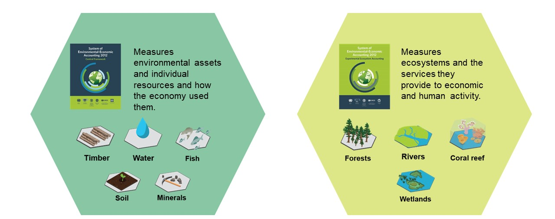
One environment, two perspectives

Slide 49
Extended measures of wealth
SEEA EA Chapter 11
Integrates SNA, SEEA CF+SEEA EA
Ecosystem types based on IUCN Global Ecosystem Typology
Prominence to natural capital (in SNA scattered across multiple categories)
Avoids double counting, but special attention for:
Cultivated biological resources
Land (SEEA definition differs from SNA definition)
Renewable energy resources
Atmosphere (special case)

Slide 50
Measuring natural capital
Stock accounts (physical units)
Opening / closing stocks and changes during the accounting period
Examples: extent of ecosystems; stocks of standing timber
Monetary asset accounts
Asset value = NPV of services provided
Revaluation; depletion and degradation (grounded in physical indicators)
Integration in sequence of accounts
(net measures) and extended balance sheet
Consistent with valuation principles of SNA
Clear distinction between “exchange value” + “welfare value”
Relation to broader measures of value
SEEA takes an economic + instrumental perspective (focus on “use”)
But recognizes broader perspectives (intrinsic values; relational values)
SEEA EA recommends that physical measures to accompany monetary measures

Slide 51
Specific issues: ownership / borders / exclusivity / (non)-produced
Several types of natural capital are public goods (non-exclusive / non-rival)
SEEA EA makes contributions to benefits (+ impacts upon them) visible
But necessitates using non-market valuation techniques
Ownership: SEEA EA -> de facto all land is owned
Ecosystem trustee as separate subsector of general government in the sectoral accounts
Produced/non-produced distinction:
SEEA perspective: gradual distinction + in Anthropocene hard to conceive of pure non-produced
Discussed as topic during SNA revision process
Other topics discussed: asset ownership, permits, depletion, biological assets as an attempt to bring the SNA closer to the SEEA.
International dimension:
SEEA EA: spatial framework; ES benefit specific users; some inherently global (climate regulation)
Imports + exports of ES

Slide 52
Some challenges with measuring natural capital
Conceptual:
Exchange value when doing non-market valuation; allowable non-market valuation techniques
-> Sub-group to discuss SNA valuation principles as part of SNA update process
Philosophical:
Nature has tremendous (welfare) value, but exchange value can be low compared to welfare value
SEEA EA (Chapter 12) discusses complementary approaches to valuation
Measurement:
Projections of future service flows (+ discounting discussions) are inherently difficult
Great advances in use of Earth Observation data + development of tools / data platform
Way forward:
SEEA EA implementation strategy includes development of tools + guidelines
Research agenda

Slide 53
Beyond GDP, broader framework
SEEA can play an important role:
SEEA has graduated from being satellite accounts towards a system on par with the SNA
SNA and SEEA complementary frameworks
With SNA and SEEA data in many countries, comprehensive datasets can be put together
UN Common Agenda -> calls for implementation of SEEA EA
SEEA status of implementation 2021: 89 countries SEEACF / 36 SEEA EA
Trends / insights from SEEA development:
Growing focus on wealth as underpinning current measures of welfare
The importance of accounts in physical data
Opportunities in bringing geospatial and statistical worlds together
Challenges between economics (welfare) and accounting approaches
Seek clarity (from policy makers / users) around number of indicators

Slide 54
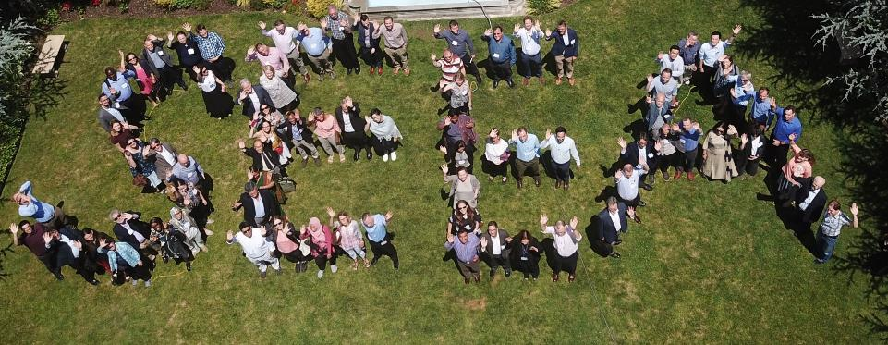

Slide 55
UN Network of Economic Statisticians 10 March 2022 Human Capital Gueorguie Vassilev – Head of Skills, Time-Use and Economic Well-being, UK

Slide 56
Contents
Existing international guidance on human capital measurement
Main current approaches and existing implementations (i.e. specific countries, some cross-country examples from OECD, World Bank, academics but no consistency)
Outstanding conceptual concerns for incorporation – where does this guidance fall short?
Commonalities with other capitals

Slide 57
Existing international guidance on human capital measurement
2001: The Well-being of Nations (OECD)
2016 Guide to Measuring Human Capital (UNECE)
Cost-based measures – most natural alignment with National Accounts framework
Income-based measures – alternative valuation welcomed by individual countries’ existing efforts
Indicators – range of options – e.g. World Bank Human Capital Index
2020 Guide to the Satellite Account on Education and Training (UNECE_

Slide 58
Drivers of change
What do users want?
Policy, research, academia
What are their expectations?
What can statistical producers provide – where evidence gaps translate to future collection needs?

Slide 59
Current conceptual situation
Good progress on several options for identifying (main) contributions to independent human capital valuation
Some reference to implications to sequence of accounts from existing approaches
Cost-based approaches identify items relating to human capital investment
Income-based approaches derive estimates for transactions and concepts that may need imputation or adjustment
Less is agreed upon in terms of consistency in measurement and valuation with other capitals
Many conceptual issues in terms of relation to SNA framework still outstanding

Slide 60
Outstanding conceptual developments - framework
Existing disconnect and gap between frameworks
Production boundary to account for human capital acquisition
Extension of coverage of ‘economic benefits’ and ‘economic activity’
Clarifying distinction between human capital and labour
Clear definition of human capital – e.g.s:
skill, knowledge or other concept that can be learned or trained individually, that can/does improve person’s employment income potential for multiple period
Individual attribute that, upon improvement or acquisition, improves associated production process over multiple periods beyond acquisition
Notes:
SNA08
3.5: An asset is a store of value representing a benefit or series of benefits accruing to the economic owner by holding or using the entity over a period of time. It is a means of carrying forward value from one accounting period to another
1.55 This treatment of education costs is consistent with the production and asset boundaries of the SNA but not all users of the SNA find it satisfactory in all instances
3.46 The coverage of assets is limited to those assets used in economic activity and that are subject to ownership rights; thus for example, consumer durables and human capital, as well as natural resources that are not owned, are excluded.
1.54 – Human Capital section within Asset Boundary discussion: It is often proposed that expenditures on staff training and education should be classified as gross fixed capital formation as a form of investment in human capital. The acquisition of knowledge, skills and qualifications increases the productive potential of the individuals concerned and is a source of future economic benefit to them. However, while knowledge, skills and qualifications are clearly assets in a broad sense of the term, they cannot be equated with fixed assets as understood in the SNA. They are acquired through learning, studying and practising, activities that cannot be undertaken by anyone else on behalf of the student and thus the acquisition of knowledge is not a process of production even though the instruction conveyed by education services is.
1.40 – production boundary: In the SNA, production is understood to be a physical process, carried out under the responsibility, control and management of an institutional unit, in which labour and assets are used to transform inputs of goods and services into outputs of other goods and services. All goods and services produced as outputs must be such that they can be sold on markets or at least be capable of being provided by one unit to another, with or without charge. The SNA includes within the production boundary all production actually destined for the market, whether for sale or barter. It also includes all goods or services provided free to individual households or collectively to the community by government units or NPISHs. Household production 1.41 The main problem for defining the range of activities recorded in the production accounts of the SNA is to decide upon the treatment of activities that produce goods or services that could have been supplied to others on the market but are actually retained by their producers for their own use.
10.11 - Fixed assets are produced assets that are used repeatedly or continuously in production processes for more than one year
3.19 and 3.20 - An economic benefit is defined as denoting a gain or positive utility arising from an action. It implies a comparison between two states. This can be elaborated within the SNA so that benefits are seen as rewards for providing services, such as those of labour and capital to production and also the means of acquiring goods and services for production, consumption or accumulation in the current period or in future periods. 3.20 Sometimes the immediate benefit is in terms of goods and services directly, for example own account production or wages and salaries in kind. More often a benefit is in the form of the medium of exchange (money), for example as wages and salaries. Consumption is an activity that takes place in the current period only but may be financed from past benefits. Production and accumulation also involve benefits postponed to future periods. Thus, means of allowing benefits to be moved from one accounting period to another have to be recognized. These take the form of assets and liabilities where a benefit in one period is converted to a benefit in one or more future periods

Slide 61
Outstanding conceptual developments - allocations
Accounting for ownership and resident boundaries
Implications from different ownership of acquisition, holding of stocks, and use in production process
Relatedly – timing of accounting for transactions (is most acquisition Work in Progress?)
Knock-on indirect impacts? Examples:
other activities being brought into production;
distributional transactions to account for different sectors’ use
Notes:
SNA08
3.5: An asset is a store of value representing a benefit or series of benefits accruing to the economic owner by holding or using the entity over a period of time. It is a means of carrying forward value from one accounting period to another
1.55 This treatment of education costs is consistent with the production and asset boundaries of the SNA but not all users of the SNA find it satisfactory in all instances
3.46 The coverage of assets is limited to those assets used in economic activity and that are subject to ownership rights; thus for example, consumer durables and human capital, as well as natural resources that are not owned, are excluded.
1.54 – Human Capital section within Asset Boundary discussion: It is often proposed that expenditures on staff training and education should be classified as gross fixed capital formation as a form of investment in human capital. The acquisition of knowledge, skills and qualifications increases the productive potential of the individuals concerned and is a source of future economic benefit to them. However, while knowledge, skills and qualifications are clearly assets in a broad sense of the term, they cannot be equated with fixed assets as understood in the SNA. They are acquired through learning, studying and practising, activities that cannot be undertaken by anyone else on behalf of the student and thus the acquisition of knowledge is not a process of production even though the instruction conveyed by education services is.
1.40 – production boundary: In the SNA, production is understood to be a physical process, carried out under the responsibility, control and management of an institutional unit, in which labour and assets are used to transform inputs of goods and services into outputs of other goods and services. All goods and services produced as outputs must be such that they can be sold on markets or at least be capable of being provided by one unit to another, with or without charge. The SNA includes within the production boundary all production actually destined for the market, whether for sale or barter. It also includes all goods or services provided free to individual households or collectively to the community by government units or NPISHs. Household production 1.41 The main problem for defining the range of activities recorded in the production accounts of the SNA is to decide upon the treatment of activities that produce goods or services that could have been supplied to others on the market but are actually retained by their producers for their own use.
10.11 - Fixed assets are produced assets that are used repeatedly or continuously in production processes for more than one year
3.19 and 3.20 - An economic benefit is defined as denoting a gain or positive utility arising from an action. It implies a comparison between two states. This can be elaborated within the SNA so that benefits are seen as rewards for providing services, such as those of labour and capital to production and also the means of acquiring goods and services for production, consumption or accumulation in the current period or in future periods. 3.20 Sometimes the immediate benefit is in terms of goods and services directly, for example own account production or wages and salaries in kind. More often a benefit is in the form of the medium of exchange (money), for example as wages and salaries. Consumption is an activity that takes place in the current period only but may be financed from past benefits. Production and accumulation also involve benefits postponed to future periods. Thus, means of allowing benefits to be moved from one accounting period to another have to be recognized. These take the form of assets and liabilities where a benefit in one period is converted to a benefit in one or more future periods

Slide 62
Outstanding conceptual developments - scope
What is human capital output?
Education, training, apprenticeships
Relationship between stocks and flows
What is the full scope of human capital investment?
E.g. Health, unpaid household production, independent learning etc
How to account for multiplicative, combinatorial nature of human capital investment?
Notes:
SNA08
3.5: An asset is a store of value representing a benefit or series of benefits accruing to the economic owner by holding or using the entity over a period of time. It is a means of carrying forward value from one accounting period to another
1.55 This treatment of education costs is consistent with the production and asset boundaries of the SNA but not all users of the SNA find it satisfactory in all instances
3.46 The coverage of assets is limited to those assets used in economic activity and that are subject to ownership rights; thus for example, consumer durables and human capital, as well as natural resources that are not owned, are excluded.
1.54 – Human Capital section within Asset Boundary discussion: It is often proposed that expenditures on staff training and education should be classified as gross fixed capital formation as a form of investment in human capital. The acquisition of knowledge, skills and qualifications increases the productive potential of the individuals concerned and is a source of future economic benefit to them. However, while knowledge, skills and qualifications are clearly assets in a broad sense of the term, they cannot be equated with fixed assets as understood in the SNA. They are acquired through learning, studying and practising, activities that cannot be undertaken by anyone else on behalf of the student and thus the acquisition of knowledge is not a process of production even though the instruction conveyed by education services is.
1.40 – production boundary: In the SNA, production is understood to be a physical process, carried out under the responsibility, control and management of an institutional unit, in which labour and assets are used to transform inputs of goods and services into outputs of other goods and services. All goods and services produced as outputs must be such that they can be sold on markets or at least be capable of being provided by one unit to another, with or without charge. The SNA includes within the production boundary all production actually destined for the market, whether for sale or barter. It also includes all goods or services provided free to individual households or collectively to the community by government units or NPISHs. Household production 1.41 The main problem for defining the range of activities recorded in the production accounts of the SNA is to decide upon the treatment of activities that produce goods or services that could have been supplied to others on the market but are actually retained by their producers for their own use.
10.11 - Fixed assets are produced assets that are used repeatedly or continuously in production processes for more than one year
3.19 and 3.20 - An economic benefit is defined as denoting a gain or positive utility arising from an action. It implies a comparison between two states. This can be elaborated within the SNA so that benefits are seen as rewards for providing services, such as those of labour and capital to production and also the means of acquiring goods and services for production, consumption or accumulation in the current period or in future periods. 3.20 Sometimes the immediate benefit is in terms of goods and services directly, for example own account production or wages and salaries in kind. More often a benefit is in the form of the medium of exchange (money), for example as wages and salaries. Consumption is an activity that takes place in the current period only but may be financed from past benefits. Production and accumulation also involve benefits postponed to future periods. Thus, means of allowing benefits to be moved from one accounting period to another have to be recognized. These take the form of assets and liabilities where a benefit in one period is converted to a benefit in one or more future periods

Slide 63
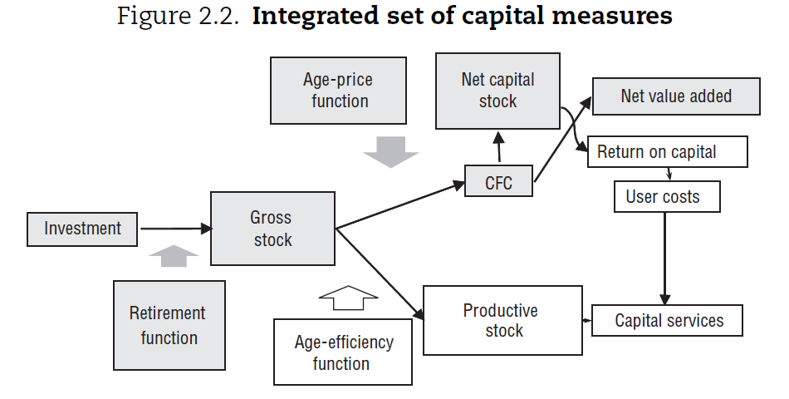
Outstanding measurement issues
Notes:
SNA08
3.5: An asset is a store of value representing a benefit or series of benefits accruing to the economic owner by holding or using the entity over a period of time. It is a means of carrying forward value from one accounting period to another
1.55 This treatment of education costs is consistent with the production and asset boundaries of the SNA but not all users of the SNA find it satisfactory in all instances
3.46 The coverage of assets is limited to those assets used in economic activity and that are subject to ownership rights; thus for example, consumer durables and human capital, as well as natural resources that are not owned, are excluded.
1.54 – Human Capital section within Asset Boundary discussion: It is often proposed that expenditures on staff training and education should be classified as gross fixed capital formation as a form of investment in human capital. The acquisition of knowledge, skills and qualifications increases the productive potential of the individuals concerned and is a source of future economic benefit to them. However, while knowledge, skills and qualifications are clearly assets in a broad sense of the term, they cannot be equated with fixed assets as understood in the SNA. They are acquired through learning, studying and practising, activities that cannot be undertaken by anyone else on behalf of the student and thus the acquisition of knowledge is not a process of production even though the instruction conveyed by education services is.
1.40 – production boundary: In the SNA, production is understood to be a physical process, carried out under the responsibility, control and management of an institutional unit, in which labour and assets are used to transform inputs of goods and services into outputs of other goods and services. All goods and services produced as outputs must be such that they can be sold on markets or at least be capable of being provided by one unit to another, with or without charge. The SNA includes within the production boundary all production actually destined for the market, whether for sale or barter. It also includes all goods or services provided free to individual households or collectively to the community by government units or NPISHs. Household production 1.41 The main problem for defining the range of activities recorded in the production accounts of the SNA is to decide upon the treatment of activities that produce goods or services that could have been supplied to others on the market but are actually retained by their producers for their own use.
10.11 - Fixed assets are produced assets that are used repeatedly or continuously in production processes for more than one year

Slide 64
Outstanding measurement issues
If income-based measure used for stock valuation, there should still be an equivalence with the above concepts
For it to be valued as an asset, what are the:
Acquisitions
Different products – qualifications, knowledge and skills, competencies, others
Learning to read, learning arithmetic vs learning advanced quantum theory or specific method of use of machinery
Different prices
Life-lengths
Age-price functions
How to square up existing monetary expenditures with real investments
Can expenditures (e.g. on education, health, training) be split between human capital-improving and on-going current?
Notes:
SNA08
3.5: An asset is a store of value representing a benefit or series of benefits accruing to the economic owner by holding or using the entity over a period of time. It is a means of carrying forward value from one accounting period to another
1.55 This treatment of education costs is consistent with the production and asset boundaries of the SNA but not all users of the SNA find it satisfactory in all instances
3.46 The coverage of assets is limited to those assets used in economic activity and that are subject to ownership rights; thus for example, consumer durables and human capital, as well as natural resources that are not owned, are excluded.
1.54 – Human Capital section within Asset Boundary discussion: It is often proposed that expenditures on staff training and education should be classified as gross fixed capital formation as a form of investment in human capital. The acquisition of knowledge, skills and qualifications increases the productive potential of the individuals concerned and is a source of future economic benefit to them. However, while knowledge, skills and qualifications are clearly assets in a broad sense of the term, they cannot be equated with fixed assets as understood in the SNA. They are acquired through learning, studying and practising, activities that cannot be undertaken by anyone else on behalf of the student and thus the acquisition of knowledge is not a process of production even though the instruction conveyed by education services is.
1.40 – production boundary: In the SNA, production is understood to be a physical process, carried out under the responsibility, control and management of an institutional unit, in which labour and assets are used to transform inputs of goods and services into outputs of other goods and services. All goods and services produced as outputs must be such that they can be sold on markets or at least be capable of being provided by one unit to another, with or without charge. The SNA includes within the production boundary all production actually destined for the market, whether for sale or barter. It also includes all goods or services provided free to individual households or collectively to the community by government units or NPISHs. Household production 1.41 The main problem for defining the range of activities recorded in the production accounts of the SNA is to decide upon the treatment of activities that produce goods or services that could have been supplied to others on the market but are actually retained by their producers for their own use.
10.11 - Fixed assets are produced assets that are used repeatedly or continuously in production processes for more than one year

Slide 65
Other capitals’ overlaps
Unpaid household production as input into human capital asset acquisition
Air and water quality - health relationship –> knock on to human capital
Relative human capital valuation when combined with differing physical assets (tech-savvy engineer with appropriate software vs tech-savvy engineer working in retail)
Multiplicative impacts to production process from human capital and organisational capital stocks in firms
Notes:
SNA08
3.5: An asset is a store of value representing a benefit or series of benefits accruing to the economic owner by holding or using the entity over a period of time. It is a means of carrying forward value from one accounting period to another
1.55 This treatment of education costs is consistent with the production and asset boundaries of the SNA but not all users of the SNA find it satisfactory in all instances
3.46 The coverage of assets is limited to those assets used in economic activity and that are subject to ownership rights; thus for example, consumer durables and human capital, as well as natural resources that are not owned, are excluded.
1.54 – Human Capital section within Asset Boundary discussion: It is often proposed that expenditures on staff training and education should be classified as gross fixed capital formation as a form of investment in human capital. The acquisition of knowledge, skills and qualifications increases the productive potential of the individuals concerned and is a source of future economic benefit to them. However, while knowledge, skills and qualifications are clearly assets in a broad sense of the term, they cannot be equated with fixed assets as understood in the SNA. They are acquired through learning, studying and practising, activities that cannot be undertaken by anyone else on behalf of the student and thus the acquisition of knowledge is not a process of production even though the instruction conveyed by education services is.
1.40 – production boundary: In the SNA, production is understood to be a physical process, carried out under the responsibility, control and management of an institutional unit, in which labour and assets are used to transform inputs of goods and services into outputs of other goods and services. All goods and services produced as outputs must be such that they can be sold on markets or at least be capable of being provided by one unit to another, with or without charge. The SNA includes within the production boundary all production actually destined for the market, whether for sale or barter. It also includes all goods or services provided free to individual households or collectively to the community by government units or NPISHs. Household production 1.41 The main problem for defining the range of activities recorded in the production accounts of the SNA is to decide upon the treatment of activities that produce goods or services that could have been supplied to others on the market but are actually retained by their producers for their own use.
10.11 - Fixed assets are produced assets that are used repeatedly or continuously in production processes for more than one year

Slide 66
Consolidation and Discussion

Slide 67
Consolidating discussion – key points
Do we agree there is a challenge in measuring modern capitals?
Are there common challenges across the different types of capitals we have discussed today?
What should we prioritise in any future work on measuring modern capitals?

Slide 68

Beyond GDP Sprint
Richard Heys (ONS) & Erich Strassner (BEA)

Slide 69
Sprint Design: Five Sessions
1. Modern Capital: Iintangible capitals (training), human capital, natural capitals, etc.
2&3. Distributional Accounts: SNA update issues, environment, wellbeing (Fitoussi, Stiglitz and Durand report)
4. Population, Society, and Wellbeing: Socio-demographic disaggregation of national accounts, vulnerability index, HDI index UN SG Beyond GDP initiative
5. Synthesis and Next Steps

Slide 70
Distributional Accounts
Part 1: Distributional Initiatives within the Core SNA research agenda
Income, Consumption, and Wealth
Aim to share examples, strategies, and best practices from ongoing
Level set on current initiatives to establish baseline for Part 2 session
Part 2: Distributional & Other Wellbeing Initiatives beyond Core SNA agenda
Move beyond the core SNA toward the frontier
Aim to learn about research and other initiatives on broader wellbeing agenda—E.g., Stiglitz, Sen, Fitoussi as well as Distributional National Accounts linked to other domains
Plus: Closing discussion on way forward

Slide 71
Distributional Accounts – March 24
Focus on initiatives associated within the Core Accounts
Presentations by International Organizations and Country Experts
OECD-Eurostat Expert Group on Disparities in a National Accounts Framework: Jorrit Zwijnenburg, OECD
Expert Group on Linking Macro & Micro Data for Household Sectors: Pierre Sola, ECB
Distributions of U.S. Personal Income: Dennis Fixler, U.S. BEA
Call for participants: Ideally two (2) additional country perspectives

Slide 72
Other Wellbeing Initiatives – April 5
Move beyond the Core toward “the frontier”
Presentations by International Organizations and Country Experts
Initiatives of the OECD Centre on Wellbeing, Inclusion, Sustainability, and Equal Opportunity: Fabrice Murtin, OECD
Call for participants: Ideally three (3) country perspectives for the broader wellbeing agenda beyond Distributional Accounts
Plus, discussion on way forward

Slide 73
Population, Society, and Wellbeing
1. National Transfer Accounts Population Division, UN DESA
How population growth and changing population age structure influence economic growth, gender and generational equity, public finances, and other important features of the macro-economy– the generational economy by disaggregating national accounts by socio-demographic characteristics
2. Human Development Index - UNDP
How to emphasize that people and their capabilities are the ultimate criteria for assessing the development of a country, not economic growth alone?
3. Vulnerability Index for sustainable development for Small Island Developing States (SIDS) - UNCTAD
How to recognize the socio-economic and environmental vulnerabilities of SIDS for inclusive growth and sustainable development?
4. United Nations Secretary General on Beyond GDP as part of the “Our Common Agenda” - UN Secretariat, UNSD, UNDP, and UNCTAD
How to secure a world where everyone can thrive in peace, dignity and equality on a healthy planet?

Slide 74
Any Questions?

